Slide 1

Seastar:Vertex-Centric Programming for Graph Neural Networks
Yidi Wu, Kaihao Ma, Zhenkun Cai, Tatiana Jin, Boyang Li, Chenguang Zheng, James Cheng, Fan Yu¶
The Chinese University of Hong Kong
¶: Huawei Technology Co.Ltd

Slide 2
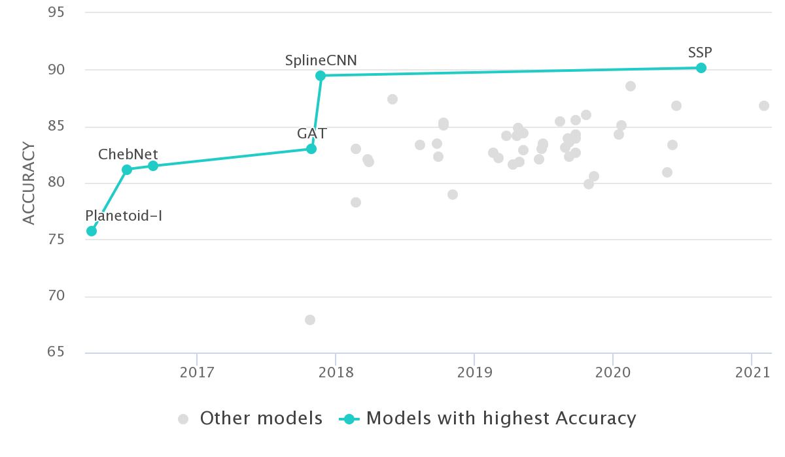
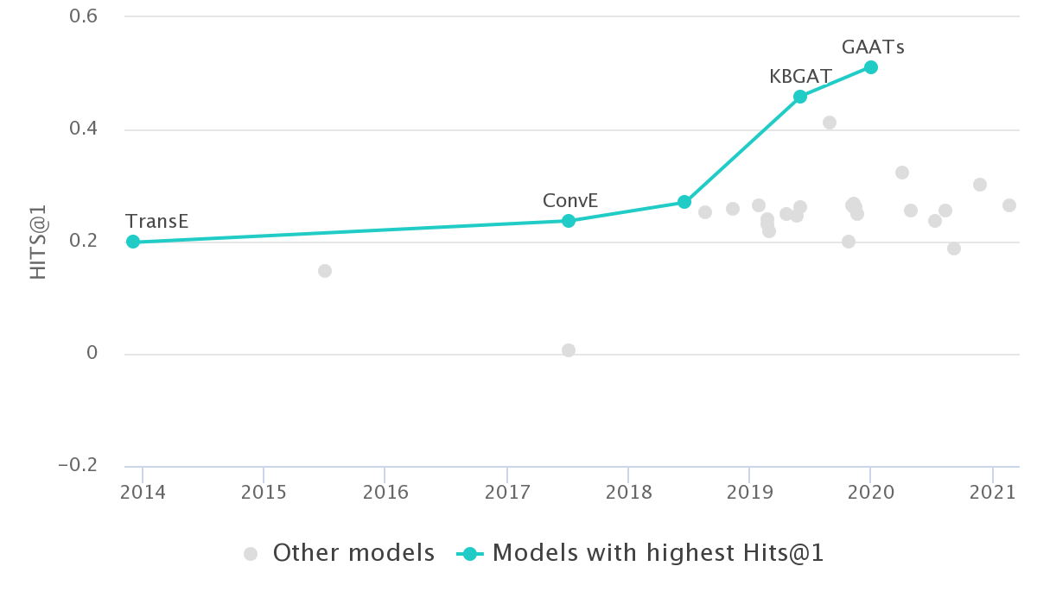
Graph Neural Networks
Better performance in many graph analytic tasks than traditional methods
Figure 1: Node classification on Cora (left) and link prediction on fb15k-237 (right) leaderboard ^{[1]}

Slide 3
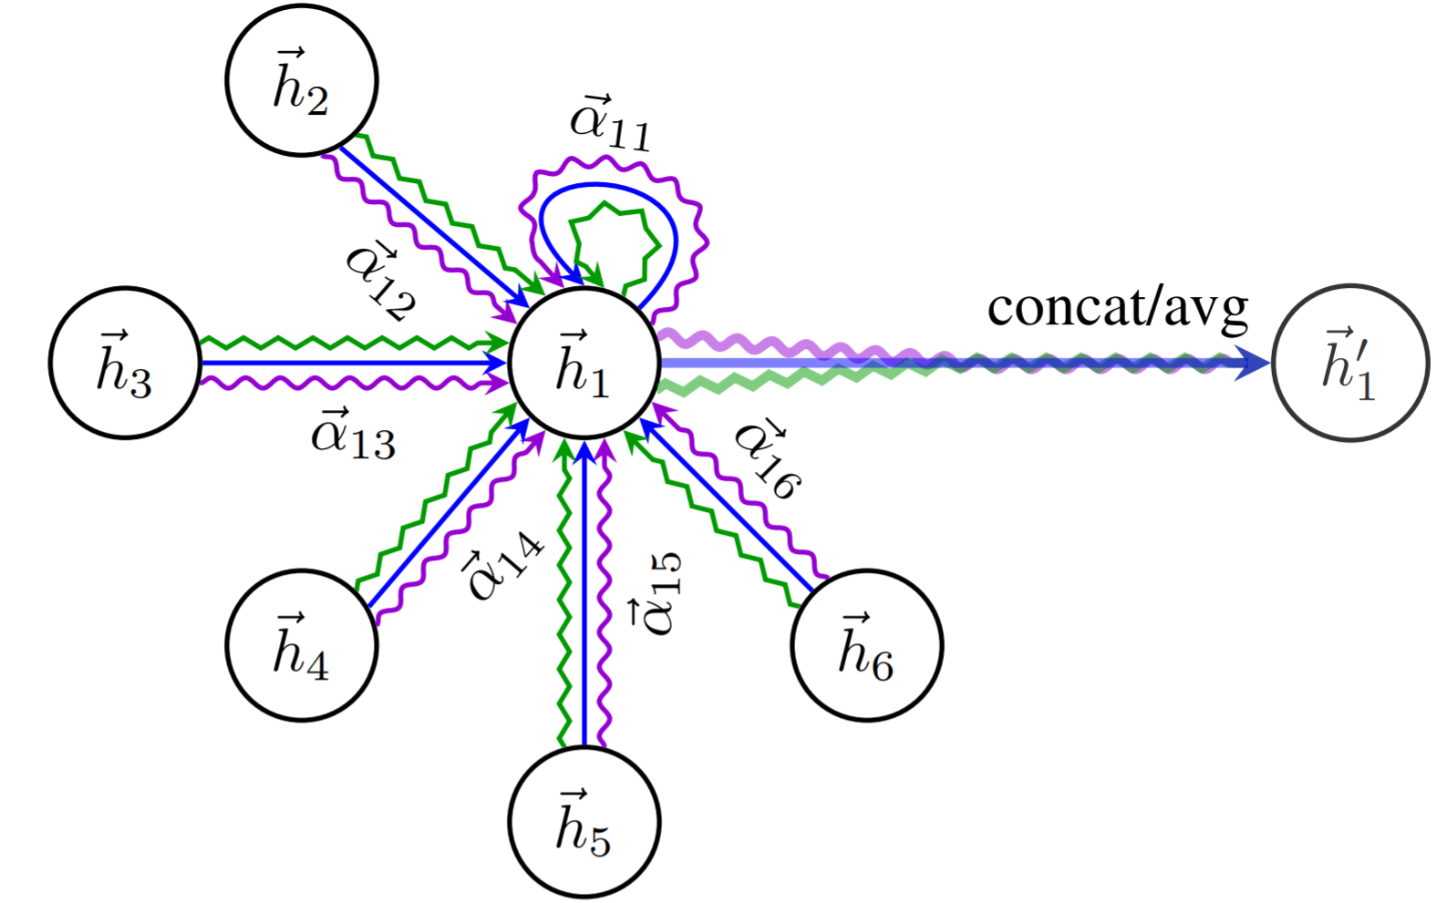
SEAStar Computation Pattern
Source
h₂
h₃
Edge
h₁
sum
h’₁
h₄
Aggregation
Figure 2: Vertex-centric view of GCN ^{[1]} (top) and GAT ^{[2]} (bottom)

Slide 4
GNN Programming Abstractions
Deep Graph Library (DGL)
Provides the Graph abstraction
Vertices’ feature vectors are grouped into tensor then stored in the graph
Graph.update_all(func.copy_u(‘x’, ’m’), func.sum(‘m’, ‘h’))
func.copy_u creates a message tensor ‘m’ by copying feature from vertex tensor ‘x’.
func.sum reduces the message tensor ‘m’ according to the destination and names the output ‘h’ (a vertex tensor)
PyTorchGeometric (PyG), NeuGraph
Organize GNN computation into stages of tensor-wise operations
PyG: message, update
NeuGraph: Scatter-ApplyEdge-Gather-ApplyVertex (SAGA)
GraphLearn, Euler
Provide sampling APIs (e.g., GraphLearn’s Gremlin-like API), no GNN specific abstraction for expressing GNN computation
Rely on operations of DL frameworks only, e.g., tf.gather, tf.segment_sum

Slide 5
GNN Execution
Tensor materialization:
Within each stage, use operators of backend DL systems (e.g., matmul, leakyRelu) to carry out computation
Across stages, Scatter/Gather operations are inserted (either by the framework or by users) to prepare the required input for next stage
GSpMM optimization in DGL:
Compute messages by add/sub/mul/div source node and edge features or copy node features to edges
Aggregate the messages by sum/max/min/mean as the features on destination node
Source
Edge
Aggregation

Slide 6
Limitations
Programming Abstraction:
Though expressive enough, users have to
cast vertex-centric pattern into whole-graph and coarse-grained tensor program
learn a set of low-level tensor operations (e.g., in GraphLearn and Euler) or domain specific APIs (e.g., in DGL, PyG and NeuGraph)
Execution:
Tensor materialization causes
high memory consumption
frequent data movements across GPU memory hierarchy
GSpMM optimization only covers a limited set of operator combinations and delivers unsatisfying performance

Slide 7
Seastar
Vertex-centric programming model that enables users to program and learn GNN models easily
Dynamically generate and compile fast and efficient kernels for the vertex-centric UDF

Slide 8
Vertex-Centric Programming Model
h₂
h₃
def gcn(v : CenterVertex):
return sum([u.h for u in v.innbs()])
h₄
h₁
sum
h’₁
def gat(v : CenterVertex):
E = [exp(leakyRelu(u.h + v.h)) for u in v.innbs()]
Alpha = [e/sum(E) for e in E]
return avg([u.h * a for u, a in zip(v.innbs(), Alpha)])
Vertex-Centric View of GCN and GAT
Vertex-Centric Implementation of GCN and GAT

Slide 9
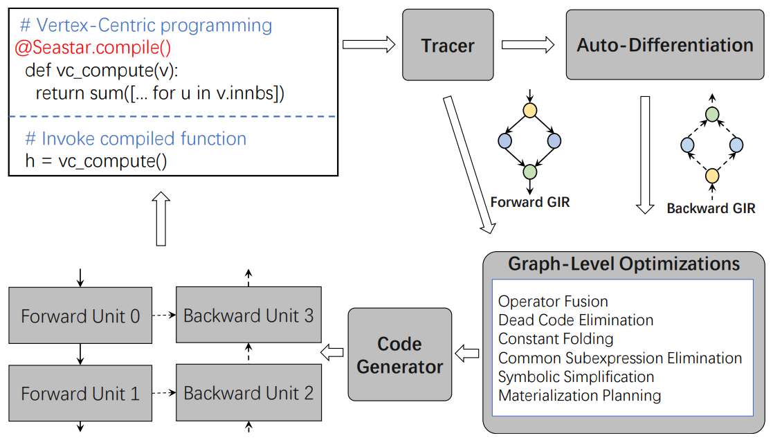
Seastar Code Generation
Record forward computational graph with operator overloading
Verify the correctness of user program
Retrieve the backward computational graph with auto-differentiation
Generate efficient CUDA kernels with execution template
Optimize the computational graph of both forward and backward passes

Slide 10
Example: GAT
def gat(v : CenterVertex):
E = [exp(leakyRelu(u.h + v.h)) for u in v.innbs()]
Alpha = [c/sum(E) for e in E]
return sum([h * a for v.h, a in zip(v.innbs(), Alpha)])
Add
LeakyRelu
Exp
AggSum
Div
Mul
AggSum
Add
LeakyRelu
Exp
AggSum
Div
Mul
AggSum
Computational Graph of GAT Annotated with Graph Type
Add
LeakyRelu
Exp
AggSum
Div
Mul
AggSum
Tensor
A-type
E-type
Fused Op
Fused Computational Graph of GAT

Slide 11
Example: GAT Backward Graph
Div
Mul
AggSum
AggSum
Div
Mul
Mul
Add
Mul
Mul
Mul
AggSum
Div
Mul
Add
BackwardLeakyRelu
Tensor
A-type
E-type
D-type
Fused Op
Notes:
.

Slide 12
Fused Kernel Execution
Dynamic Block Scheduling: Launch as many thread blocks as needed to cover al vertices.
Pros:
Less load skew than static assignment;
Reduce overhead of explicit scheduling (e.g., using atomics).
CUDA threads
Thread Block-1 (256 threads)
FAT-1 (16 threads)
FAT-2 (16 threads)
…
…
FAT: Feature Adaptive Threads group.
Pro: Group size changes according to the dimensionality of feature vector to exploit feature-wise parallelism.
V1
V2
…
…
Vertex-parallelism: Exploiting the locality of destination feature.
Pros:
Can avoid aggregation conflict;
Destination feature only needs to be load/write once.
Con: skewed load for power-law graphs
Visit Sequentially
Visit Sequentially

Slide 13
Vertex Degree Sorting
Graph structure is fixed (for full-graph training) or is independent across mini-batch (in the case of sampling-based training)
We can sort the vertices in descending order of in-degree in the background
Benefits:
We can avoid high-degree vertices become the “straggler” by assigning early launched blocks to vertices in the front
computation of high-degree vertices can be overlapped with that of low-degree ones
Reducing intra-block load imbalance (when the feature size is small)
since consecutive vertices have similar degrees

Slide 14
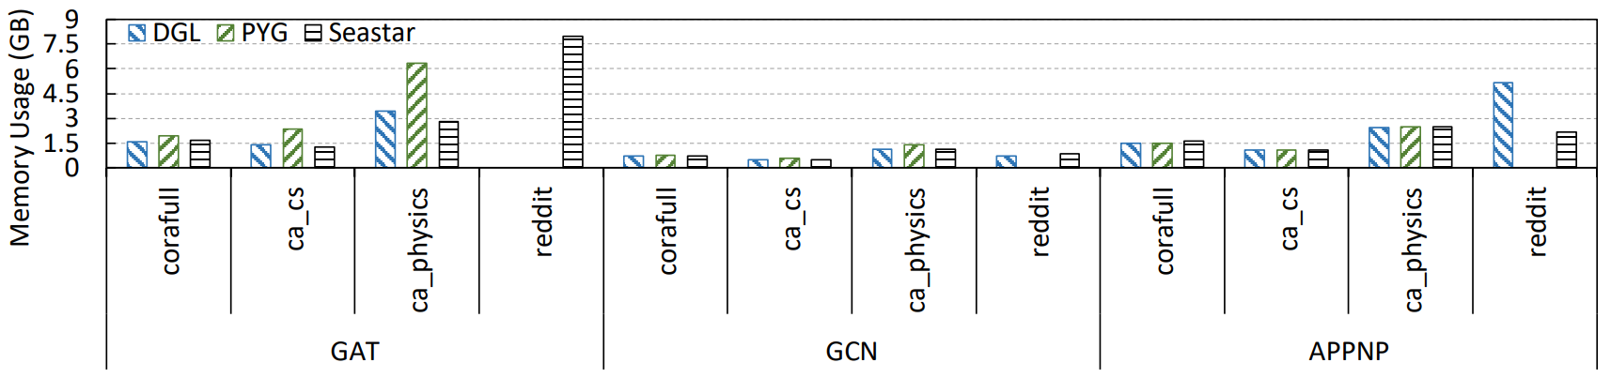
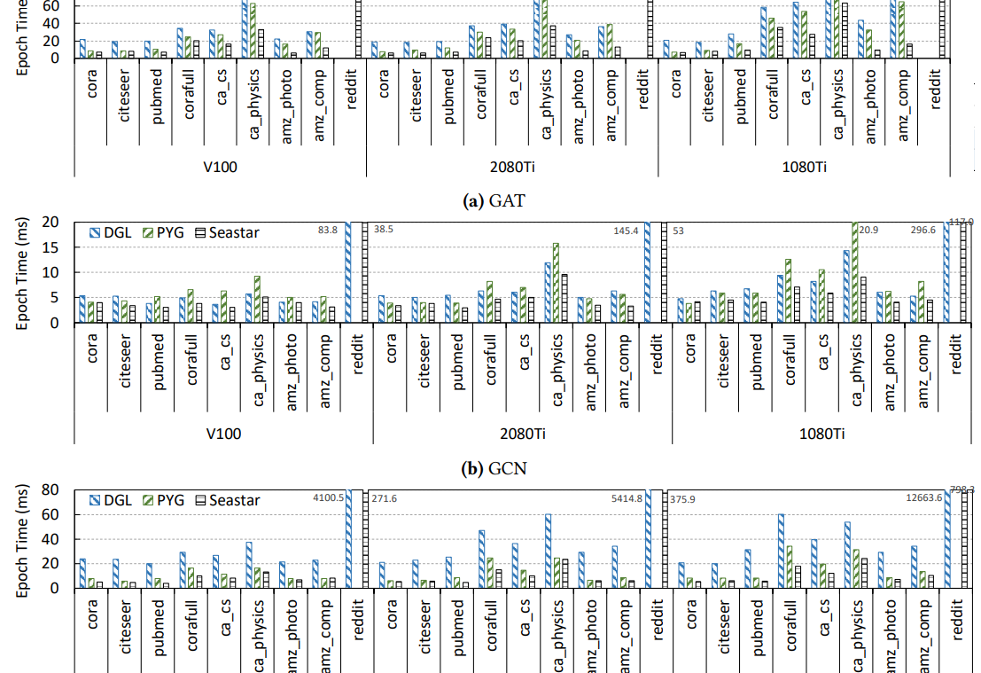
Evaluation
Less memory consumption especially for complex model training on large graphs
Up to 14 times speed-up compared with DGL and up to 3 times compared with PyG
By exploiting operator fusion opportunities and high-performance kernel design

Slide 15
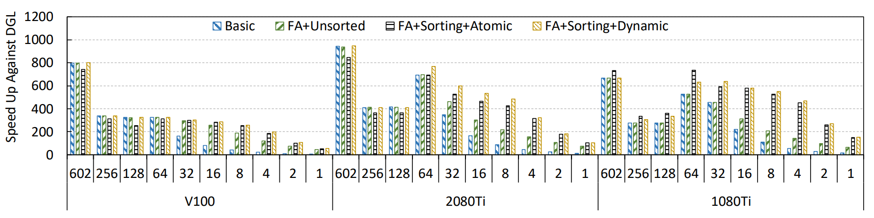
Evaluation
Benchmarking the time of fetching all neighbor's feature for all vertices. Only show the speed up against baseline:
Baseline: DGL’s edge-parallel design
Basic: Vertex-parallel with static FAT size 256
FA+Unsorted: Change the FAT size according to feature size
FA+Sorting+Atomic: Sort the vertices and use atomic instructions to assign vertices to thread block
FA+Sorting+Dynamic: Seastar’s complete design
Up to 946 times faster than baseline
FAT and Sorting significantly improve the performance when the feature size is small

Slide 16
Summarize
Better usability with vertex-centric programming
Better performance by applying compilation optimizations
Notes:
To summarize, Seatar provides a vertex-centric programming model to make it easy to write and learn GNN models
Seastar achieves better performance by applying optimizations such as operator fusion during compilation.

Slide 17
Q & A
Notes:
This is the end of presentation. Thanks!

